Slide 1
Computer Organization and Architecture (AT70.01)
Comp. Sc. and Inf. Mgmt.
Asian Institute of Technology
Instructor: Dr. Sumanta Guha
Slide Sources: Patterson &
Hennessy COD book website
(copyright Morgan Kaufmann)
adapted and supplemented

Slide 2
COD Ch. 1
Computer Abstractions and Technology

Slide 3
Introduction
Rapidly changing field:
  vacuum tube -> transistor -> IC -> VLSI
  doubling every 1.5 years:
    memory capacity
    processor speed (due to advances in technology and hardware organization)
  cute example: if Boeing had kept up with IBM we could fly from Bangkok to HCM City in 10 minutes for 5 baht (2000 dong) !!
Things we’ll be learning:
  how computers work, what’s a good design, what’s not
  how to make them – yes, we will actually build working computers!!
  issues affecting modern processors (e.g., caches, pipelines)

Slide 4
The Five Classic Components of a Computer
Input (mouse, keyboard, …)
Output (display, printer, …)
Memory
  main (DRAM), cache (SRAM)
  secondary (disk,
  CD, DVD, …)
Datapath
Control
Input
Output
Processor
(CPU)
Processor
Control
Memory
1001010010110000
0010100101010001
Datapath
1111011101100110
1001010010110000
1001010010110000
1001010010110000

Slide 5
Our Primary Focus
The processor (CPU)…
  datapath
  control
…implemented using millions of transistors
…impossible to understand by looking at individual transistors
we need...

Slide 6
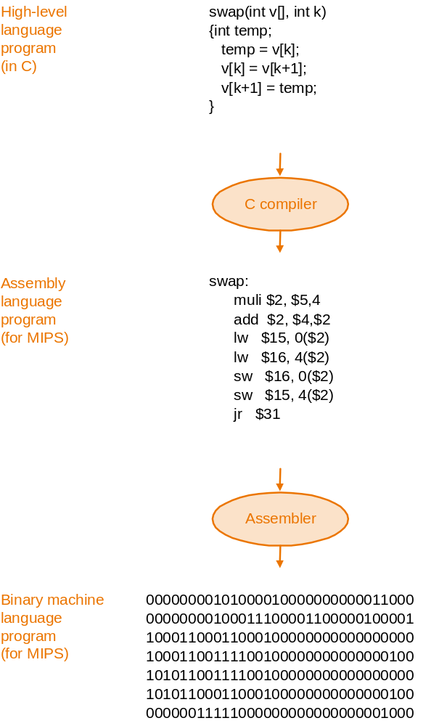
Abstraction
Delving into the depths reveals
more information, but…
An abstraction omits “unneeded”
detail, helps us cope with complexity
From the figure on the right, how
does abstraction help the programmer
and how does she avoid too much
detail?

Slide 7
The Instruction Set: a Critical Interface
software
instruction set
hardware

Slide 8
Instruction Set Architecture
A very important abstraction:
  interface between hardware and low-level software
  standardizes instructions, machine language bit patterns, etc.
  advantage: allows different implementations of the same architecture
  disadvantage: sometimes prevents adding new innovations
Modern instruction set architectures:
  80x86/Pentium/K6, PowerPC, DEC Alpha, MIPS, SPARC, HP

Slide 9
What is Computer Architecture?
Easy Answer
Computer Architecture =
Instruction Set Architecture +
Machine Organization

Slide 10
What is Computer Architecture?
Better (More Detailed) Answer
Application
Operating
System
Compiler
Firmware
Instruction Set
Architecture
Instars. Set Proc.
I/O system
Datapath & Control
Digital Design
Circuit Design
Layout

Slide 11
Forces on Computer Architecture
Technology
Programming
Languages
Applications
Computer
Architecture
Operating
Systems
History

